Slide 1
Lecture 19: Root Locus Continued
Angle and magnitude condition review
Detailed root locus examples

Slide 2
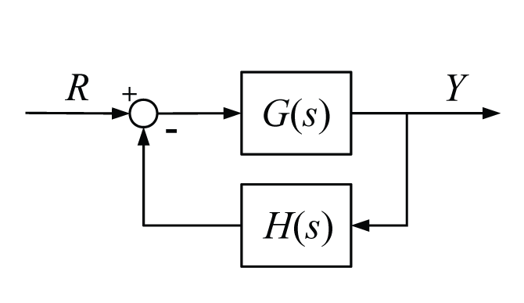
Root Locus Review
The root locus is a plot of how the closed-loop poles move for different values of a parameter K
The root locus can be drawn based on the open-loop transfer function

Slide 3
Root Locus Review
Therefore, any point s on the root locus must satisfy
the following two relations for some value of K
Angle Condition
Magnitude Condition
Which translates to:
Which implies that:
branches of the root locus start at open-loop poles and end at open-loop zeros
from
OL zeros
from
OL poles

Slide 4
Rules for Drawing the Root Locus
Locate OL poles and zeros in the s-plane
Determine root locus on the real axis
Approximate the asymptotes of the root locus
Approximate break-away and break-in points
Determine angles of departure and arrival
Find Imaginary axis crossings

Slide 5
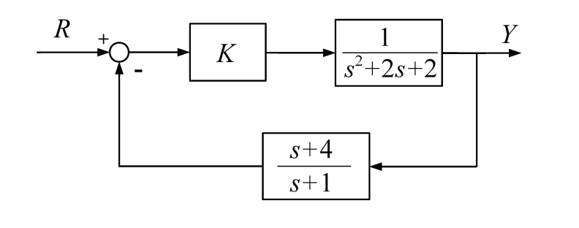
Detailed Example
Plot the Root Locus for the following system
STEP 1: Locate open-loop poles and zeros

Slide 6
Detailed Example (continued)
(branches start at OL poles and end at OL zeros)
Im
Re

Slide 7
Step 2
Determine root locus on real axis (use angle condition and recall angle from conjugate pairs cancel)
in general, branches lie to the left of an odd number of poles and zeros

Slide 8
Step 3
Approximate asymptotes
# of asymptotes = # of zeros at infinity
one zero at infinity
two zeros at infinity
three zeros at infinity
four zeros at infinity

Slide 9
Step 4
Approximate break-away/break-in points
(this root locus does not have any)
In general, occur when branches come together
Break-always tend to occur between poles on real axis
Break-ins tend to occur between zeros on real axis (including zeros at “infinity”)

Slide 10
Step 5
Determine angles of departure/arrival
use angle condition to test points around poles (departure) and around zeros (arrival)

Slide 11
Step 6
Find imaginary axis crossings
points on imag axis have zero real part, s = jω
sub s = jω into and solve for ω and K

Slide 12
Step 6 (continued)
Can use this approach to find gains to achieve other closed-loop pole locations (substitute s = -σ ± jω)

Slide 13
Detailed Example #2
Plot the Root Locus for the system with open-loop transfer function

Slide 14
Detailed Example #2 (continued)
Im
Re

Slide 15
Detailed Example #2 (continued)

Slide 16
Detailed Example #2 (continued)

